Slide 1

Introduction into fMRI analysis. PsyMsc4 (Goethe 2021).
Session-3
Javier Ortiz-Tudela and Francesco Pupillo
1
Notes:
1

Slide 2
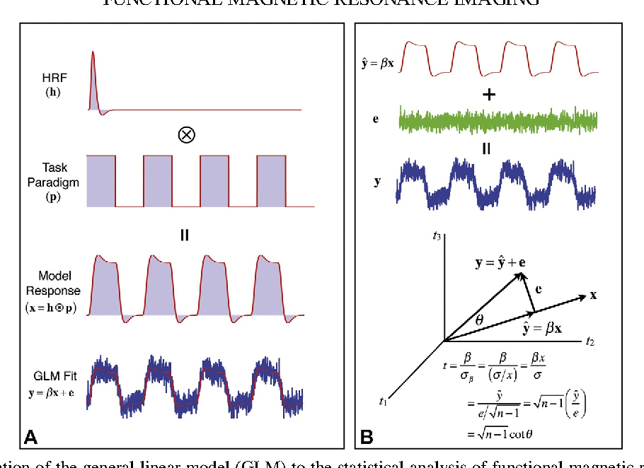

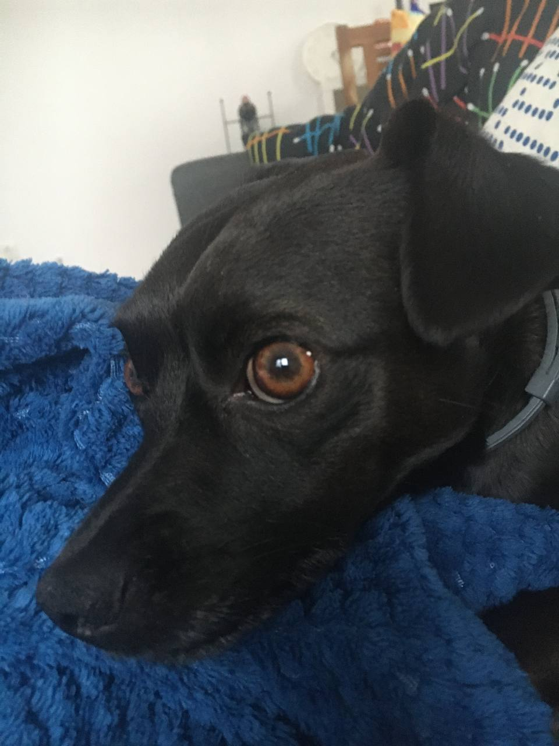
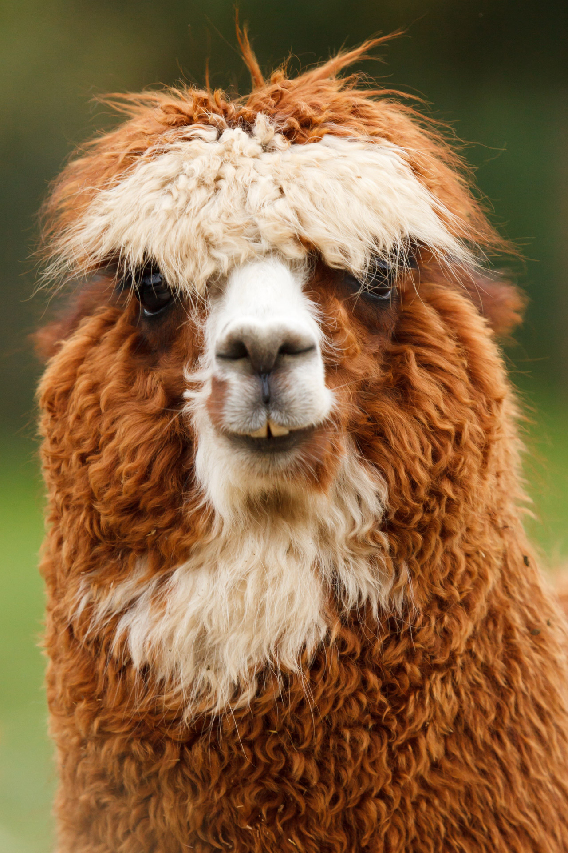
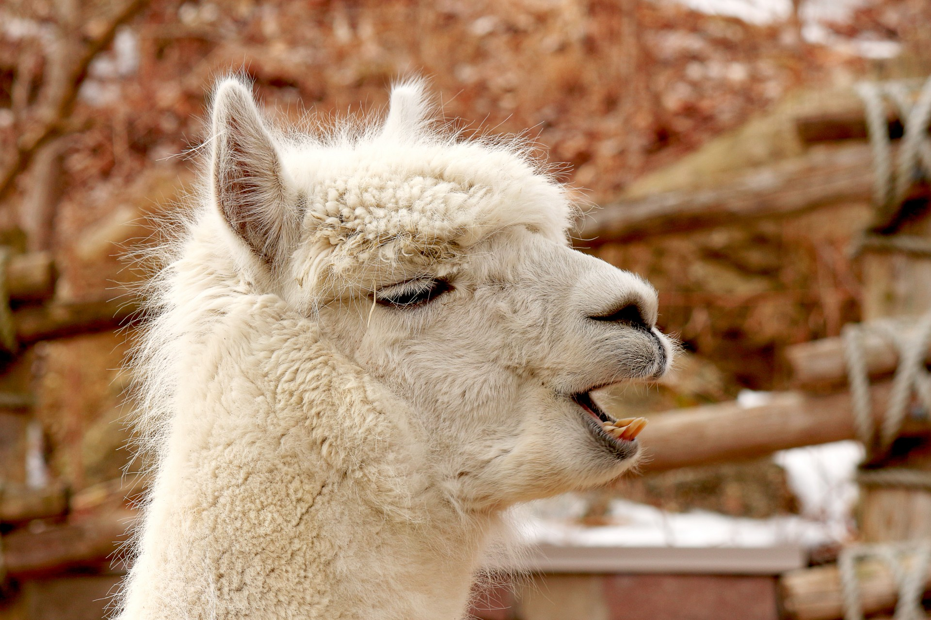
Recap of last week
General recap.
- fMRI sequences measure BOLD signal.
Regression is the usual approach to analyze BOLD signal change.
We use the condition (or stimulus) time course to model BOLD time course in each voxel.
Regression will give us beta estimates for each voxel.
The number (and meaning) of each beta estimates depends on the task model that we use.
Nuisance regressors can help “cleaning” our signal.
Estimations on head motions are the most common nuisance regressors used.
Beta1
Beta2
2
Notes:
2

Slide 3
Functional MRI. Inference.
Our GLM (linear regression) outputs beta estimates for each one of our regressors.
How should we interpret them?
Beta1
Beta2
3
Notes:
3

Slide 4
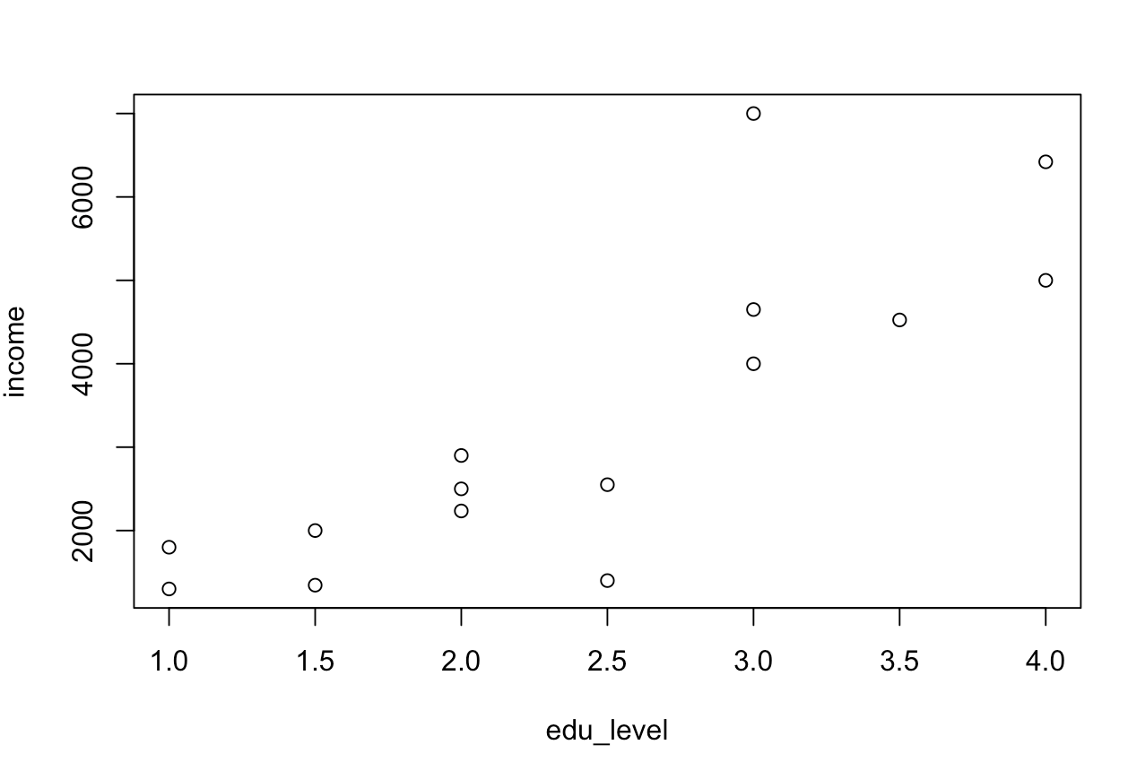
Functional MRI. Inference.
Our GLM (linear regression) outputs beta estimates for each one of our regressors.
However, we cannot draw inferences directly from betas. Why?
A “real life” example: Let’s predict income from education level.
Income in USD and education level from 1 (High school) to 4 (PhD)
beta = 1561.6
4
Notes:
4

Slide 5
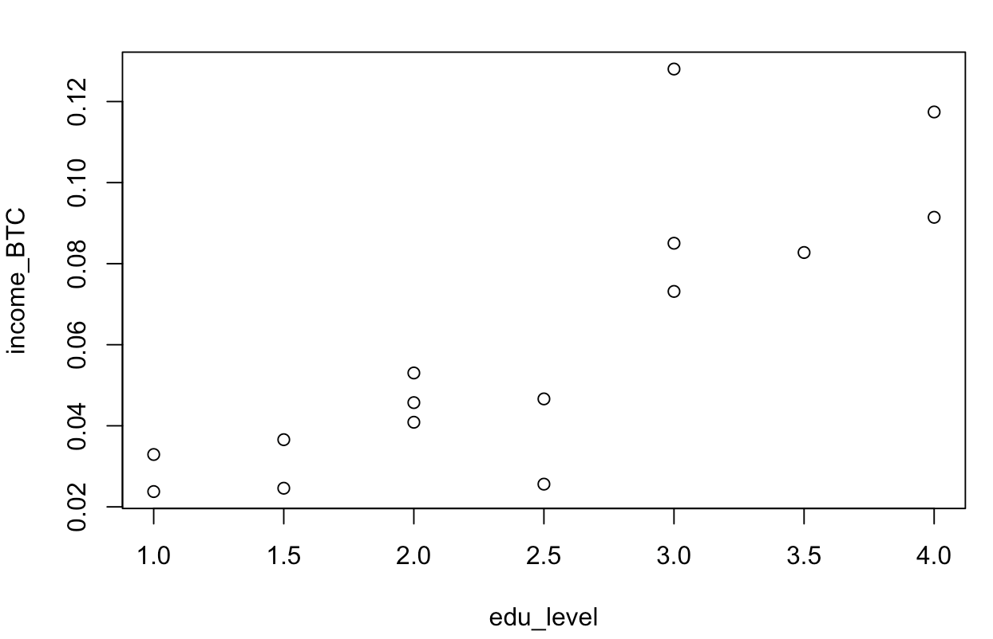
Functional MRI. Inference.
Our GLM (linear regression) outputs beta estimates for each one of our regressors.
However, we cannot draw inferences directly from betas. Why?
A “real life” example: Let’s predict income from education level.
Income in BTC and education level from 1 (High school) to 4 (PhD)
beta = 0.0286
5
Notes:
5

Slide 6
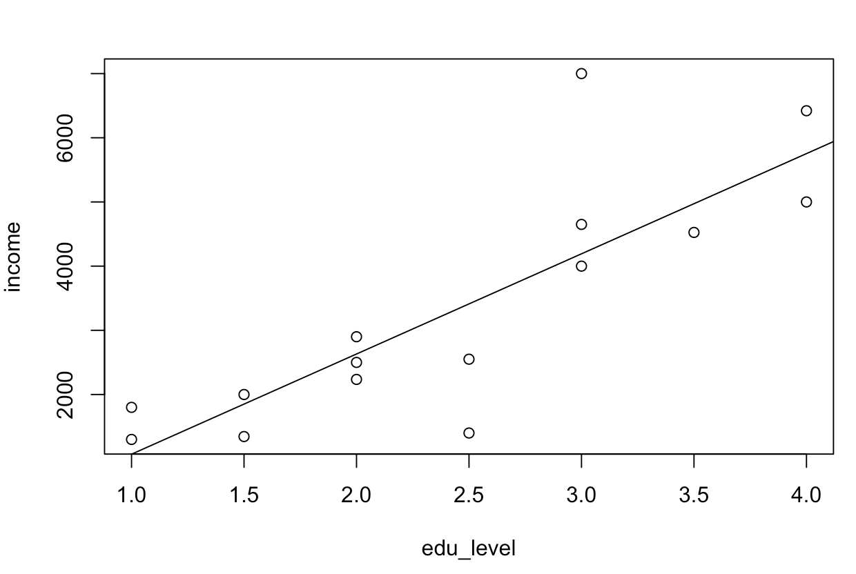
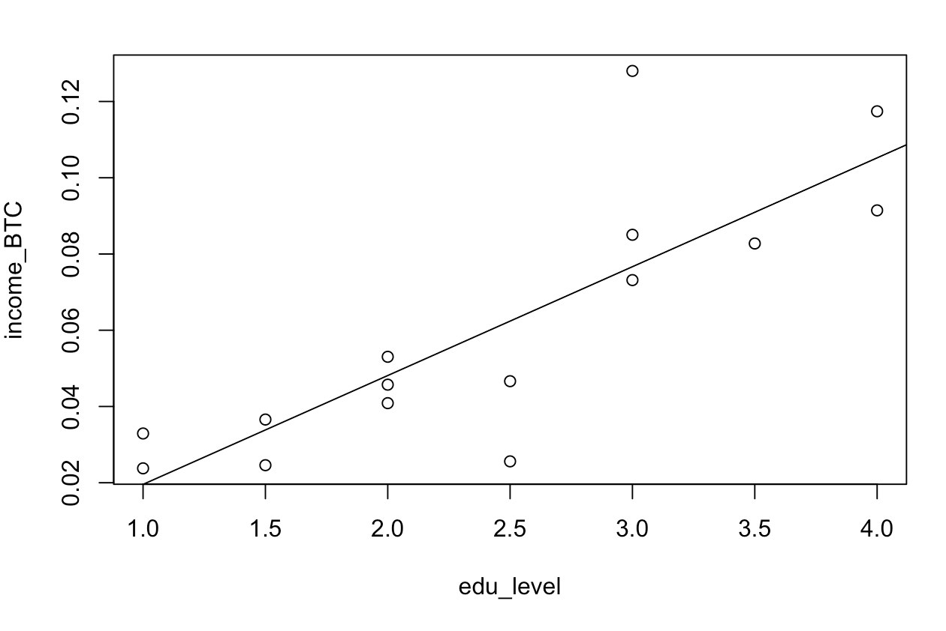
Functional MRI. Inference.
Our GLM (linear regression) outputs beta estimates for each one of our regressors.
However, we cannot draw inferences directly from betas. Why?
A “real life” example: Let’s predict income from education level.
Income in USD -> beta = 1561.6
Income in BTC -> beta = 0.0286
6
Notes:
6

Slide 7
Functional MRI. Inference.
We need to convert them to something meaningful.
Enter the t-statistic!
Only brief description since there’s no need to manually compute it
Beta1
Beta2
7
Notes:
7

Slide 8
Functional MRI. Inference.
A critical concept in fMRI research: contrasts.
Different types of contrasts:
T-tests
Against baseline.
Between regressors.
F-tests
Beta1
Beta2
8
Notes:
8

Slide 9
Functional MRI. Inference.
A critical concept in fMRI research: contrasts.
T-test against (implicit) baseline.
Beta1
Beta2
9
Notes:
9

Slide 10
Functional MRI. Inference.
A critical concept in fMRI research: contrasts.
T-test against baseline.
Enter contrast vectors: What are they, why are they useful and why are they important?
Beta1
Beta2
10
Notes:
10

Slide 11
Functional MRI. Inference.
A critical concept in fMRI research: contrasts.
T-test against baseline.
Enter contrast vectors: What are they, why are they useful and why are they important?
1
Beta1
0
Beta2
11
Notes:
11

Slide 12
Functional MRI. Inference.
A critical concept in fMRI research: contrasts.
What if we want to have a finer question? Which voxels are more active for DOG FACES than for ALPACA FACES?
QUESTION:
How should we set the contrast vector?
Beta1
Beta2
12
Notes:
12

Slide 13
Functional MRI. Inference.
A critical concept in fMRI research: contrasts.
What if we want to have a finer question? Which voxels are more active for DOG FACES than for ALPACA FACES?
Dogs > Alpacas
1
Beta1
-1
Beta2
13
Notes:
13

Slide 14

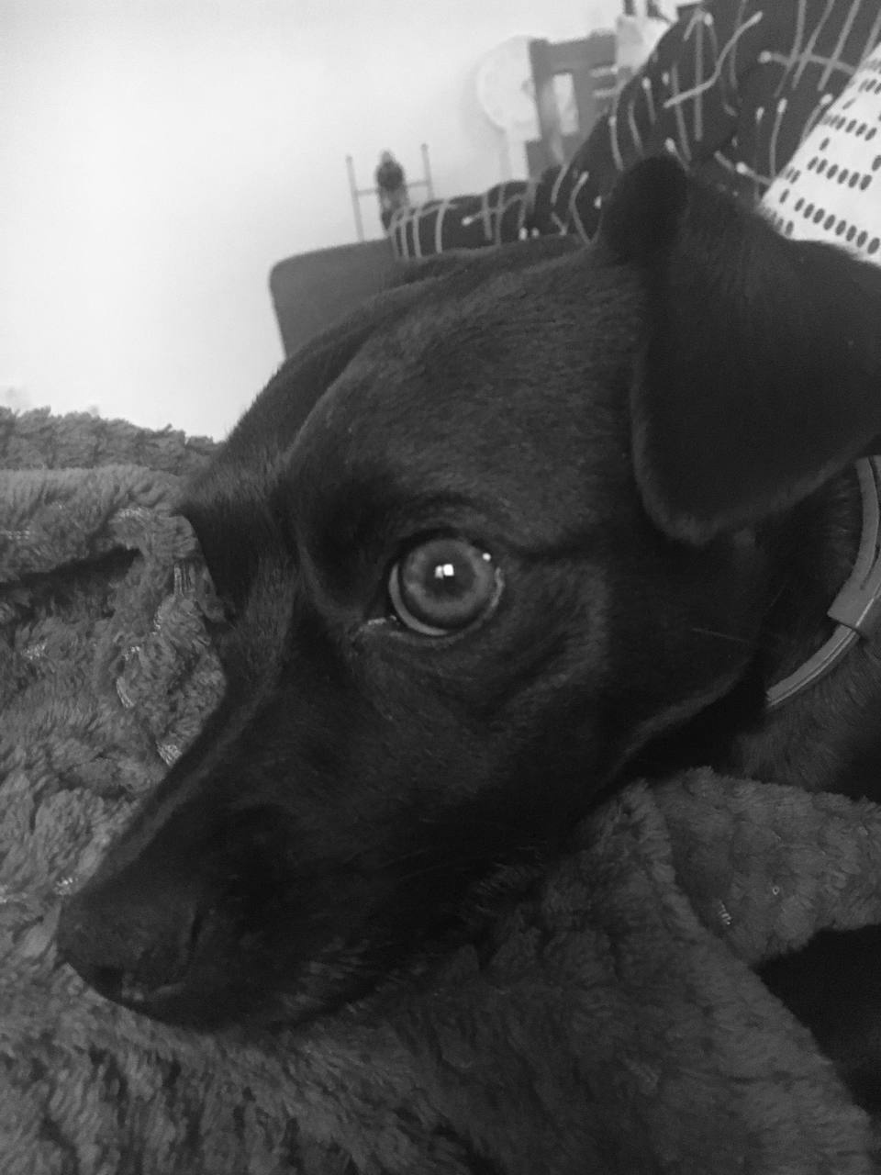
Functional MRI. Inference.
A critical concept in fMRI research: contrasts.
What if our question is more complex?
Does the brain response to staring differ between dog faces and alpaca faces?
F-tests
14
Notes:
14

Slide 15
Functional MRI. Inference.
A critical concept in fMRI research: contrasts.
What if our question is more complex?
Does the brain response to staring differ between dog faces and alpaca faces?
F-tests
Beta1
Beta2
Beta3
Beta4
“One beta per trials is estimated”
15
Notes:
15

Slide 16
Functional MRI. Inference.
A critical concept in fMRI research: contrasts.
What if our question is more complex?
Does the brain response to staring differ between dog faces and alpaca faces?
F-tests
Dogs > Alpacas
Staring > Side-ways
1
1
Beta1
1
-1
Beta2
-1
1
Beta3
-1
-1
Beta4
“One beta per trials is estimated”
16
Notes:
16

Slide 17
Functional MRI. Inference.
IMPORTANT NOTE:
Your fMRI experiment is only as good as your baseline.
Can we find the love brain region?
Can we find brain areas related to political affiliation?
Can we find voxels for Jennifer Aniston?
Beta1
Beta2
17
Notes:
17

Slide 18
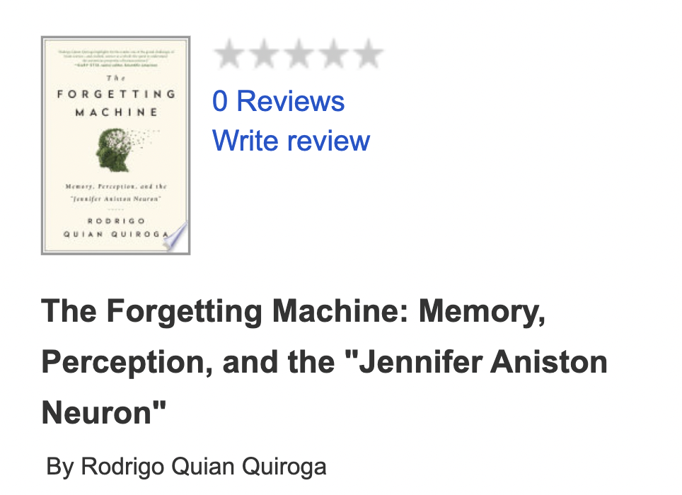
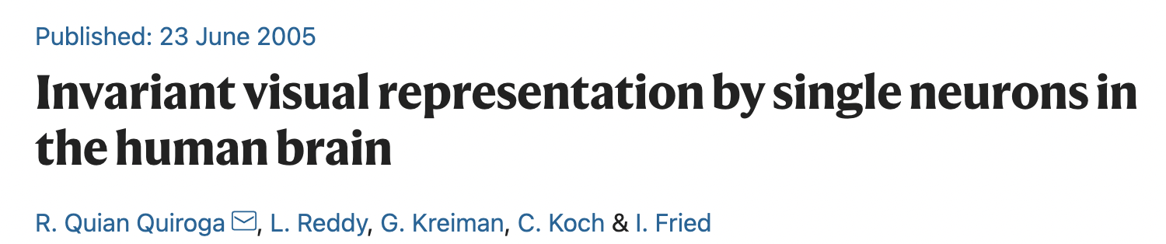
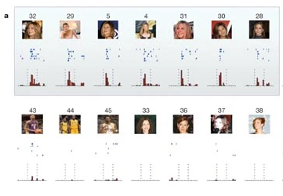
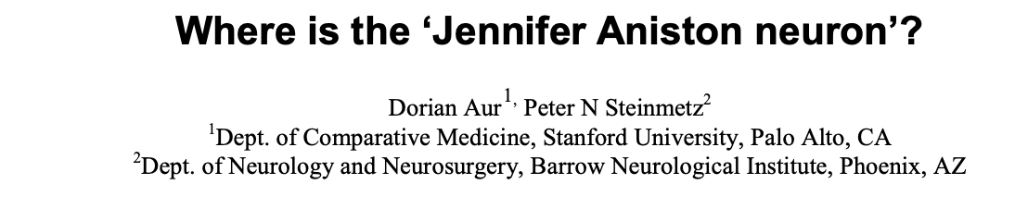
Functional MRI. Inference.
IMPORTANT NOTE:
Your fMRI experiment is only as good as your baseline.
Can we find the love brain region?
Can we find brain areas related to political affiliation?
Can we find voxels for Jennifer Aniston?
Beta1
Beta2
18
Notes:
18

Slide 19
GLM
General recap.
Beta estimates cannot be interpreted directly.
T and F contrasts can be used to compare conditions.
Beware of contrasts against implicit baseline.
Contrast vectors are widely used and powerful.
When designing an experiment, always chose an appropriate baseline.
Beta1
Beta2
Notes:
19

